Slide 1
Haploidentical hematopoietic cell Transplantation for Lymphoma
Maryam Barkhordar MD
Shahrivar 1399
Shariaty Hospital

Slide 2
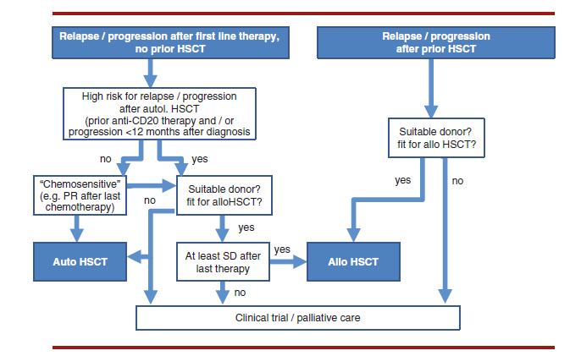
EBMT hand book 2019

Slide 5
Encouraging results have been reported with HAPLO after a nonmyeloablative regimen and post-transplantation cyclophosphamide (PTCy) as GVHD prophylaxis.

Slide 6
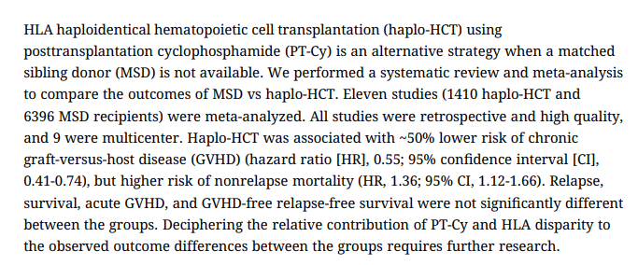
M A Meybodi, Blood advances, 2019

Slide 7
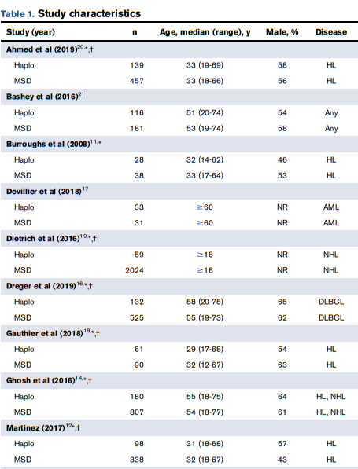
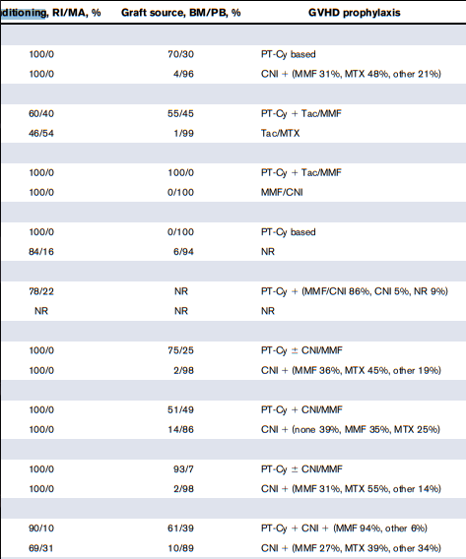

Slide 8
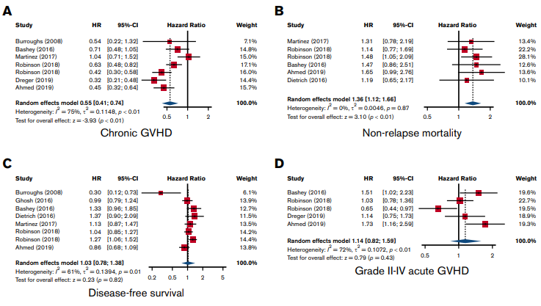

Slide 9
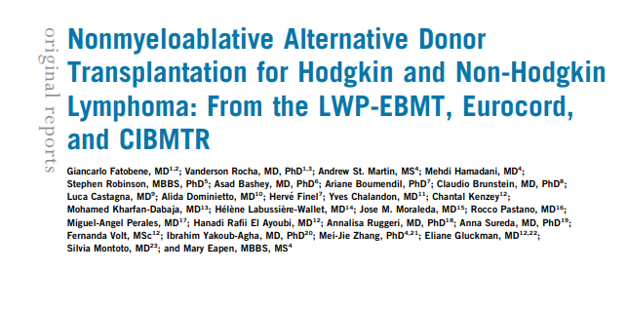
To compare the outcomes of patients with Hodgkin or non-Hodgkin lymphoma undergoing nonmyeloablative haploidentical or unrelated cord blood (UCB) hematopoietic cell transplantation.
G Fatobene, J Clin Oncol, 2020

Slide 10
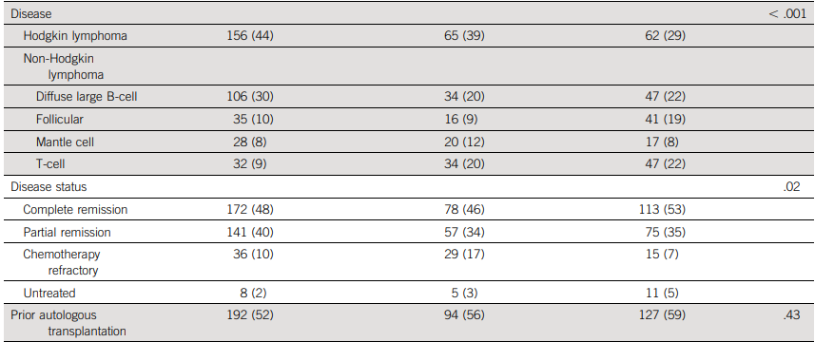
G Fatobene, J Clin Oncol, 2020

Slide 11
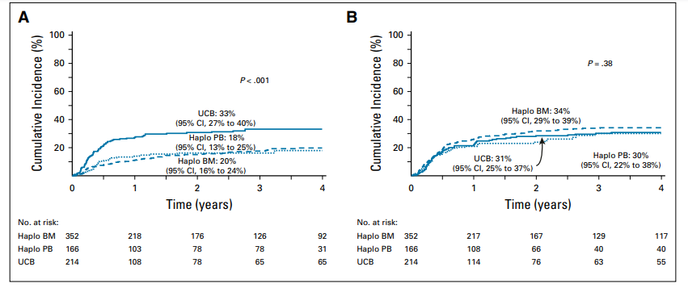
(A) Transplantation-related mortality
(B) Relapse or progression
G Fatobene, J Clin Oncol, 2020

Slide 12
Relapse
Relapse risks were higher in patients with diffuse large B-cell lymphoma (DLBCL; HR, 2.30; P , .0001) and mantle cell lymphoma (HR, 2.13; P = .007) compared with Hodgkin lymphoma (interaction P = .34)
and patients with disease status of partial response (HR, 1.93; P , .0001) and chemotherapy refractory (HR, 3.39; P , .0001) compared with complete remission (interaction P = .23)
G Fatobene, J Clin Oncol, 2020

Slide 13
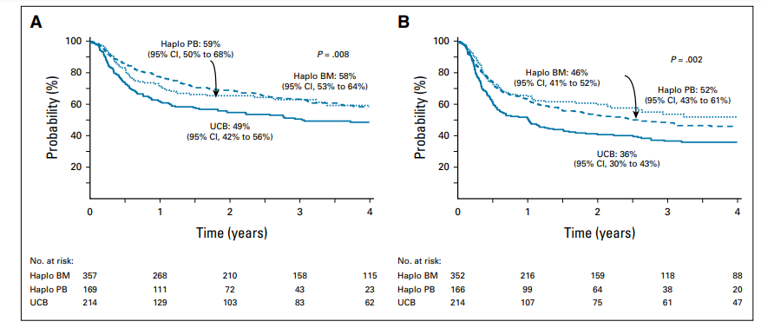
(A) Overall survival.
(B) Progression-free survival.
G Fatobene, J Clin Oncol, 2020

Slide 14
Overal survival:
Risks were higher for patients with DLBCL (HR, 1.75; P = .002) and T-cell lymphoma (HR, 1.64; P = .01) (interaction P = .81);
and patients with a disease status of partial response (HR, 1.49; P = .002) and chemotherapy refractory (HR, 2.29; P , .0001) compared with complete remission
(interaction P = .33).
G Fatobene, J Clin Oncol, 2020

Slide 15
P Dreger, Blood advances, 2019

Slide 16
P Dreger, Blood advances, 2019

Slide 17
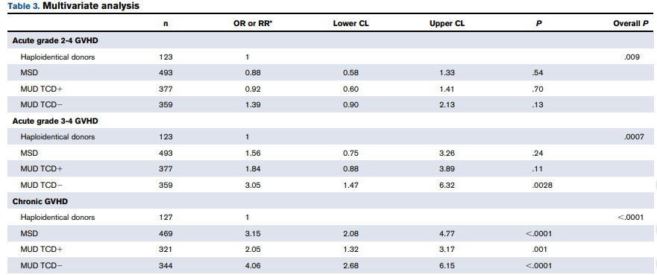
P Dreger, Blood advances, 2019

Slide 18
A total of 1438 patients (haplo, 132; MSD, 525; MUD TCD1, 403; and MUD TCD2, 378) were included
• Three-year OS and PFS after haplo-HCT was 46% and 38%, respectively, in DLBCL
• PTCy-based haplo-HCT provides lower chronic GVHD rates compared with matched sibling or unrelated donor HCT in DLBCL.
This study suggests that in DLBCL outcome after RIC haplo-HCT with PTCy may be comparable to that after RIC allo-HCT using matched donors despite a lower risk of chronic GVHD.
P Dreger, Blood advances, 2019

Slide 19
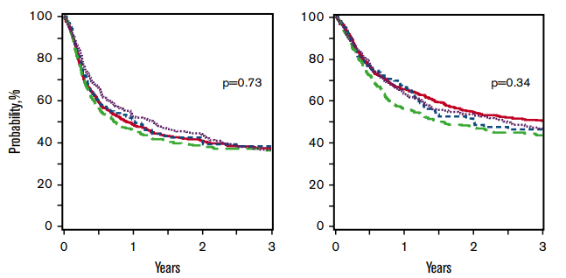
PFS OS
P Dreger, Blood advances, 2019

Slide 20
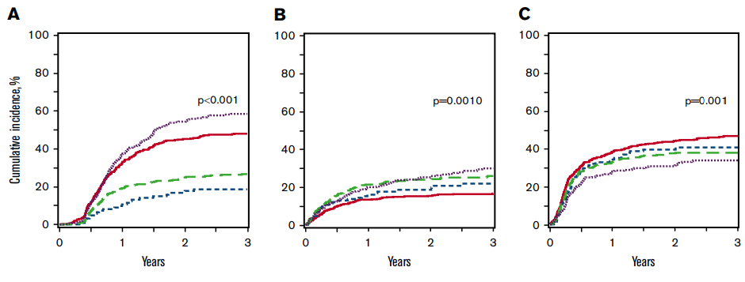
P Dreger, Blood advances, 2019

Slide 22
Nonmyeloablative Conditioning Regimen before T Cell Replete Haploidentical Transplantation with Post-Transplant Cyclophosphamide for Advanced Hodgkin and Non-Hodgkin Lymphomas
CatalinaMontes de Oca¹LucaCastagna²ChiaraDe Philippis²StefaniaBramanti²Jean
C Montez, bbmt, 2020

Slide 23
147 patients with advanced lymphoma were included
Incidence of grade II to IV acute GVHD was 30%.
Two-year cumulative incidence of all grades of chronic GVHD was 13%
Two-year cumulative incidence of disease relapse was 19% with a higher incidence in patients not being in CR at allo-HCT (CR versus not CR: 12% versus 33%, P = .006)
Two-year PFS, OS, and GRFS were 66%, 73%, and 56% ,respectively
C Montez, bbmt, 2020

Slide 24
Nonmyeloablative haploidentical stem cell transplantation for advanced lymphomas is highly feasible with low incidence of nonrelapse mortality.
It provides a strong graft-versus-lymphoma effect for both Hodgkin and non-Hodgkin lymphoma, with low incidence of relapse when performed in partial or complete remission.
C Montez, bbmt, 2020

Slide 25
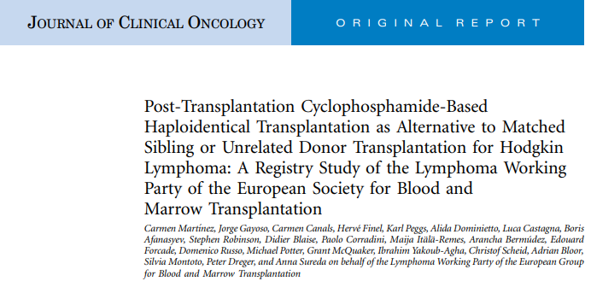
C Martinez, J Clin Oncol, 2017

Slide 26
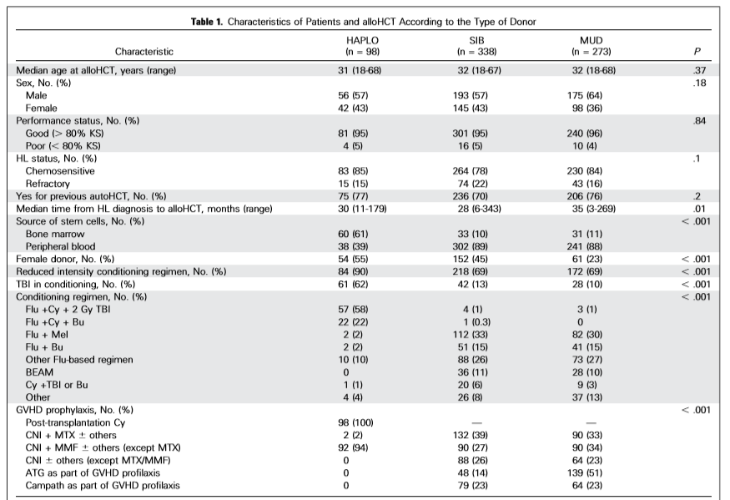

Slide 27
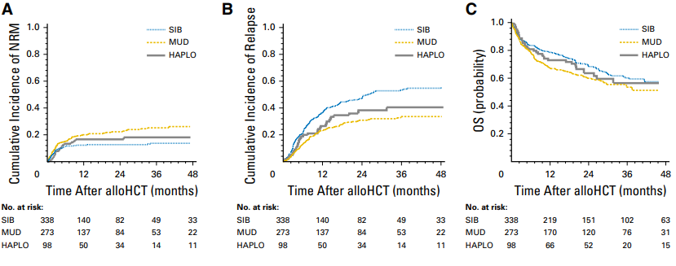
C Martinez, J Clin Oncol, 2017

Slide 28
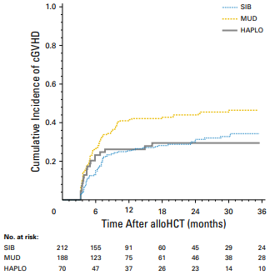
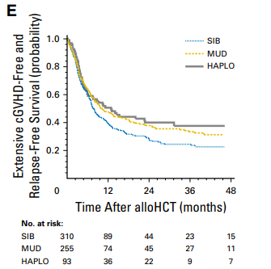
C Martinez, J Clin Oncol, 2017

Slide 29
